Slide 1
Final Project
Semantic Rules, Symbol Table, Three Address Code, Quadruples, Machine Code(TM)

Slide 2
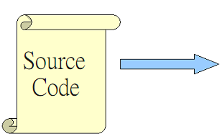
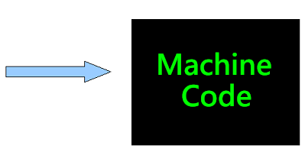
Lexical Analysis
Syntax Analysis
Semantic Analysis
IR Generation
IR Optimization
Code Generation
Optimization
PA 1
PA 2
Final
Final
TM

Slide 3
Final Project
1st: Build Semantic Rules
2nd: Build Single Symbol Table (output1.txt)
3rd: Generate Three Address Code
4th: Generate Quadruples (output2.txt)
5th: Generate Machine Code (Tiny Machine Simulator Code) (output3.tm)
Deadline : 27th June 2013, 11:55am
Upload to moodle
Demo : 28th June 2013, 9am~12pm

Slide 4
Final Project
4 people in 1 group
Target -> 3 output files
output1.txt : Symbol Table
output2.txt : Quadruples
output3.tm : “Machine Code”
Machine Code that Tiny Machine can read & run
Semantic Rules NOT Provided
Write by yourself
Grammar NOT Restricted
Grammar of PA02 (Original or Modified)

Slide 5
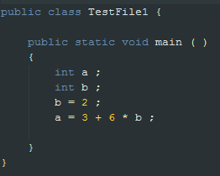

Output1 - Symbol Table
Token, Symbol, Type, Scope/Block
Token
Type
Scope 0
Scope 1
Scope 2
Symbol
Scope/ Block

Slide 6
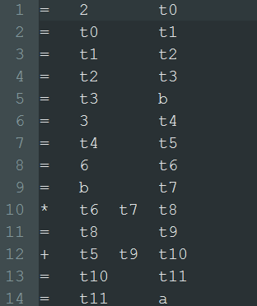
Output2 - Quadruples
Arg1
Op, Arg1, Arg2, Result
Result
Op
Arg2

Slide 7

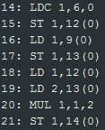
Output3 – Machine Code

Slide 8


Output3 – Machine Code
Two things before end
Add “OUT 1,0,0” at the last to output the result.
Add “HALT 1,0,0” to end the TM.

Slide 9
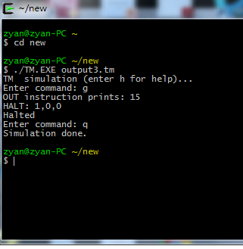
TM -- Simulation
./TM.EXE <file.tm>
“g” for execute
“q” for quit
Result

Slide 10
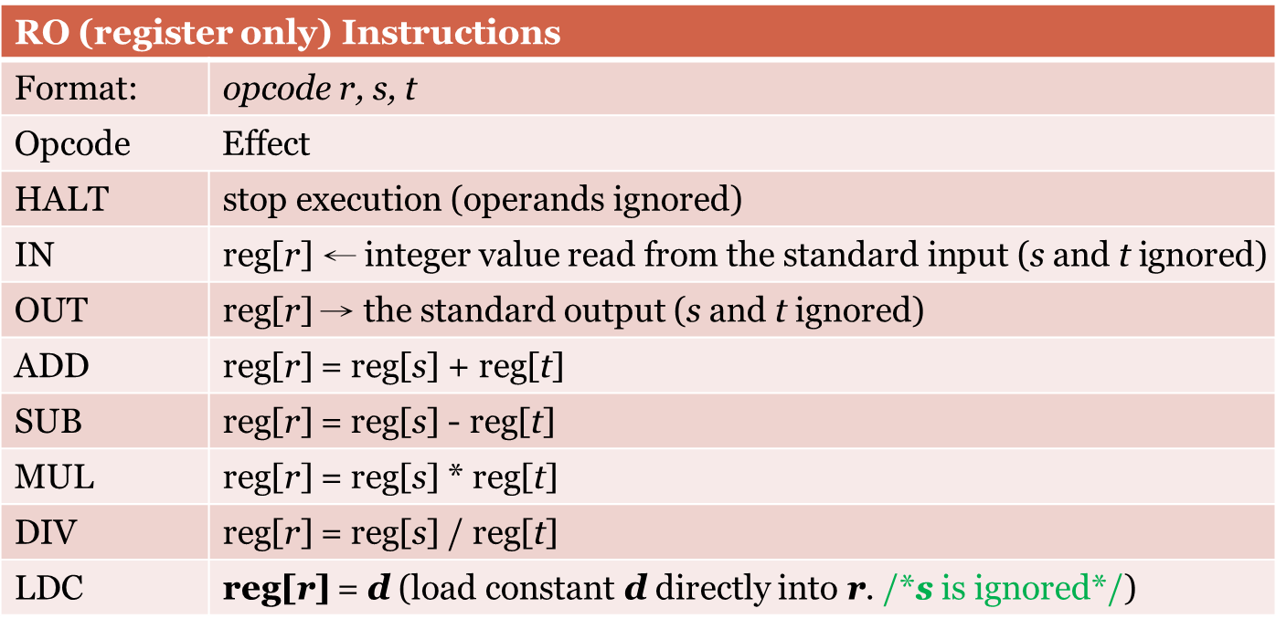
TM -- Code

Slide 11
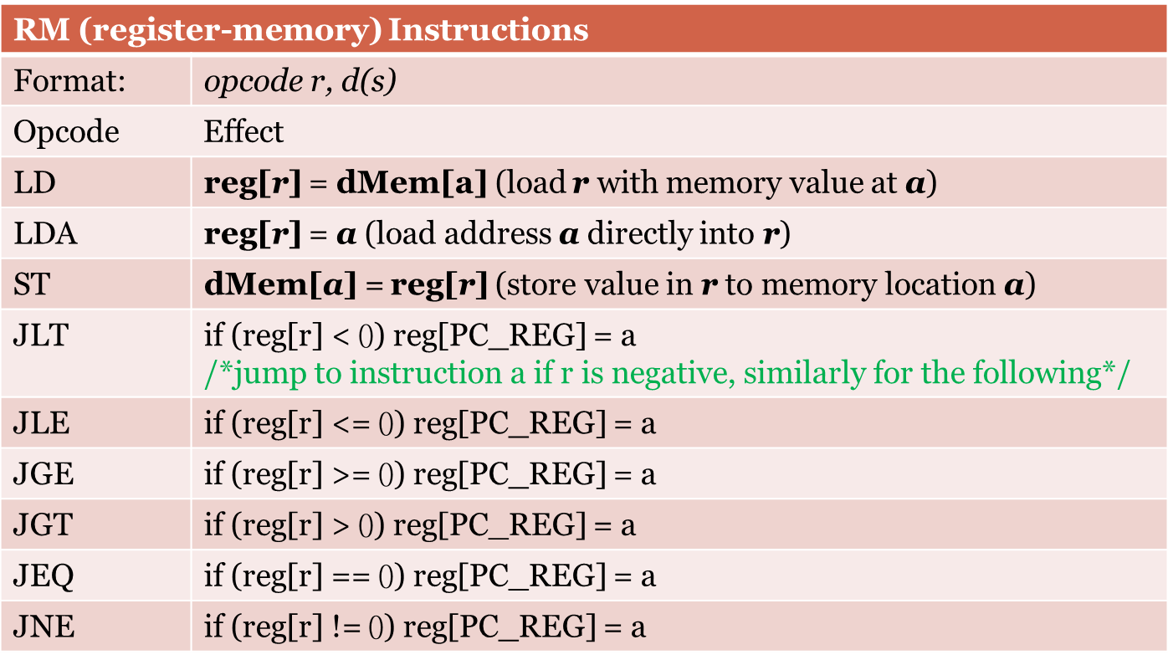
TM -- Code

Slide 12
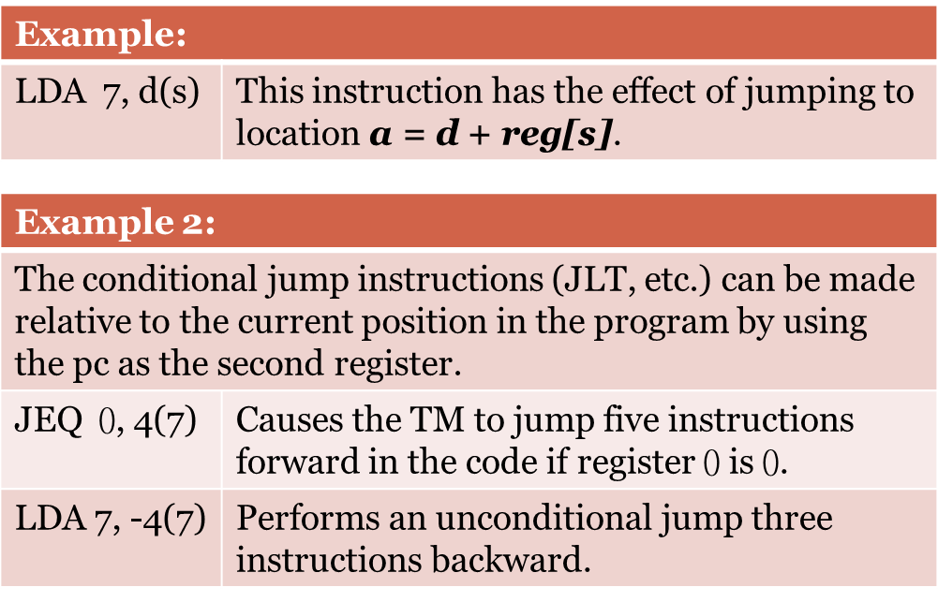
TM -- Others
The TM has only 8 registers. reg[0] ~ reg[7].
reg[7] = PC_REG.

Slide 13
Grade
Basic (60%):
output1.txt – 20%
output2.txt – 20%
output3.tm – 20%
“+ - * /” – Add, Minus, Multiply, Divide
Advance (25%):
If…else – 10%
While – 10%
Array (Include declare & assign) – 5%
Readme – 10%
Coding Style – 5%

Slide 14
Q&A

